Slide 1
file content type
A guide for new users to the
content management system (CMS)
for ec.europa.eu/info

Slide 2
How to use the file content type in the /info site
This presentation will show you everything you need to know to use the file content type for the /info site.
If you have not already done so, we recommend that you click through the CMS introduction presentation, which will prepare you with concepts and terminology used in this presentation.
This presentation will show you
when to use the file content type
how to upload a file that is then hosted on the site CMS
how to link to a document hosted on another site
how to replace an existing file with a new version
how to add other language versions of the same file
At the end, you’ll have 3 urls of file nodes you worked on, which you need to provide in your request for /info site CMS access.

Slide 3
When to use the file content type
Use the file content type in the following cases
you want to upload a document for site users to download, using file formats such as .pdf, .zip
you want to link to a document on 2 of the commission’s document databases, EUR-Lex and Regdoc
you want to create a download link to a document hosted on another site
Don’t use the file content type
if the file is an image or video: add them using the add media button in a rich text editor field.
if the file is already available in the CMS, don’t upload multiple versions of the same file. Search in the backend to check if the file exists first.

Slide 4
Front end display of files
Files hosted on the site are displayed as a grey bar with a download button, with direct access to all available language versions where applicable.
Files hosted on other sites are displayed as a link which indicates the file type that the link points to.
File nodes that link to documents on a web page in Regdoc or EUR-Lex are displayed with the external link symbol

Slide 5
Before we begin – download test files
Go to the page where you got this presentation (link below). Use your usual method to download the 2 files, or follow the instructions below.
https://webgate.ec.europa.eu/fpfis/wikis/display/WEBRAT/Exercise%3A+using+the+file+content+type
In chrome and firefox
right click the link
select open link in new tab
In microsoft edge
right click the link
select save target as
The file should appear as a download. Save it where you can find it when prompted later in the exercise.
(If you have difficulty downloading the pdf from the wiki, call the IT helpdesk on 77777.)

Slide 6
Getting started: how to name uploaded files
When you upload a file to the site, it will be stored in the media library which is shared by all /info site users.
It’s important that all file names are
unique
Multiple files with the same name are not possible – the CMS will add a number after the entered name
consistent
to help other users easily search for a file, or check whether it already exists in the library
Therefore, always use the following file naming convention.
name-of-the-file_year_language.file-extention
name-of-the-file_monthyear_language.file-extention
Examples:
emi-annual-report_2018_en.pdf
eu-charter-fundamental-rights_082012_fr.pdf

Slide 7
Log in to the CMS
We’ll use the training environment which is a nearly identical simulation of the /info site.
If you’re already logged in, skip this step.
In your web browser
Go to: https://webgate.ec.europa.eu/multisite/info-training/ecas
Use your EU login password to login.

Slide 8
Upload a file
Link to a document on another site

Slide 9
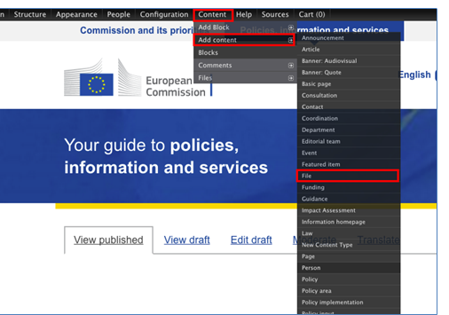
Create a new file node
Whether you will upload a file to be hosted on the /info site,
or link to a file hosted on another site, the first step is the same.
Once you’re logged in, go to
https://webgate.ec.europa.eu/multisite/info-training
On the black toolbar on the top of the page
hover on Content
go to Add content
select File

Slide 10
Give the file node a title
You are going to upload the European livestock inspectorate annual activity report for 2019.
In the Title field, enter a clear, descriptive title.
See the examples on the next slide for inspiration

Slide 11
File node title examples
Always use the following format for file node titles:
[Type of document] : [Short name of the file] – [author (if applicable)] – [official identifier (if applicable)] – [date (if relevant)]
Presentation: Adding value through internal audit - Leva-Rottiers
Study: Crowdfunding: Mapping EU markets and events - DOI: 10.2874/37466
Citizens' summary: Structural reform of the banking sector
Report: Reforming the structure of the EU banking sector - Liikanen
CV - Günther Oettinger
Meeting minutes: REFIT Platform - 29 January 2016
What to do with dates (follow the style guide ☺)
Write out dates in full:
day in figures, month spelled out, year in 4 digits

Slide 12
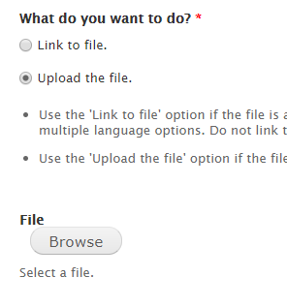
Scenario 1: Upload a file to the site
Scroll part of the way down the page to where you see What do you want to do
Select the Upload the file radio button
Click Browse.
Wait for the media browser to load.
4. In the media browser
choose Browse, to locate the file from your PC
select the file in the browser and click Open
Use the test file you downloaded on slide 5.
click the Upload button to the right of the field
click Next at the bottom of the media browser
select Public local files served by the webserver
click Next
click Save

Slide 13
Groups audience
On the editorial settings tab, find the Groups audience field group.
The groups audience field corresponds with the content class your content is in:
Business, Economy, Euro
Food, Farming, Fisheries
etc.
The effect of this field is to restrict the CMS users who can edit it. Only those who have access to edit in the assigned group (also called editorial team) will be able to edit this piece of content.
Most CMS users only have access to assign content to 1 or 2 groups audience.
Select from the dropdown list to choose the groups audience for this piece of content.

Slide 14
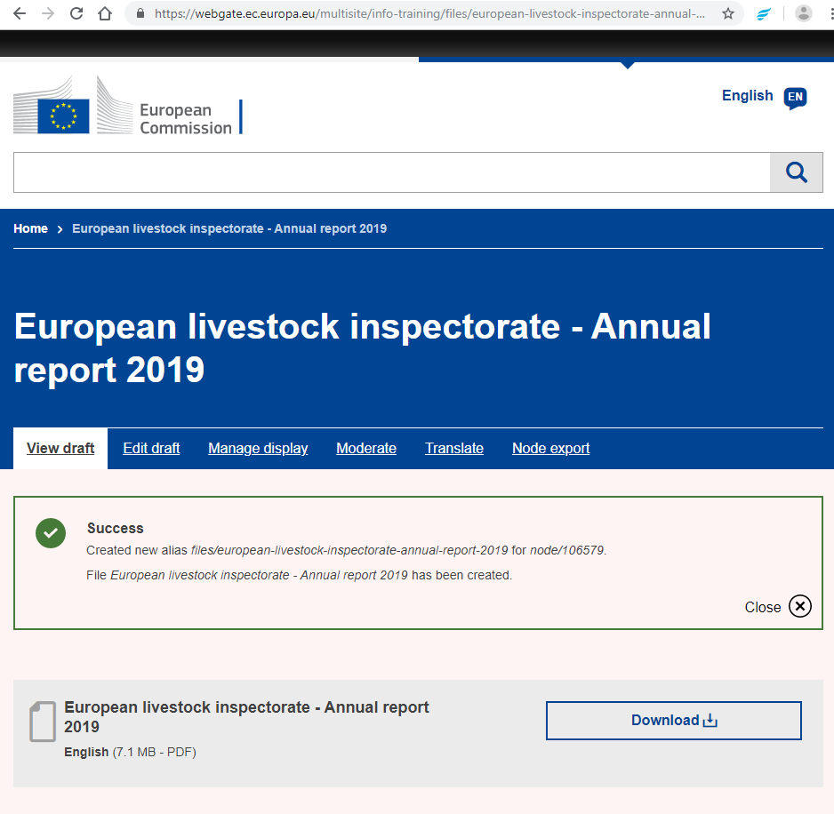
Save as needs review
Scroll to the bottom of the page.
Click the Publishing options tab
Set the Moderation state to Needs review
Click Save
Success!
Keep a note of the url of your file node
and join it to your request for access to the /info site CMS.

Slide 15
Scenario 2: link to a document on another site, including Regdoc and EUR-Lex
Use these steps whether the document is a downloadable file (e.g. a .pdf) or, as with legislation on EUR-Lex, a webpage.
Go to EUR-Lex and choose any current piece of law you like.
Create a new file node as before. In the Title field, enter a short title for the law you chose.
Example node title: Regulation: Livestock and meat statistics (EC) No 1165/2008
Under What do you want to do? Ensure Link to file is selected.
Under URL, insert full url of the EUR-Lex web page.
Under Where do you link to, indicate the appropriate source, or if the source is not listed, select no source.

Slide 16
Scenario 2 : Unique identifier
Scroll down to the unique identifier field.
Whenever a document has a unique identifier or reference number, enter it here as it helps search engines find it. It also prevents multiple copies of the same document being added to the CMS.
If you indicate EUR-Lex in the Where do you link to field, the unique identifier field is required.
Here’s where to find the unique identifiers on the EUR-Lex page of a law.
Hint: You can enter more than one identifying number, if necessary. In that case, use the ‘add another item’ button and enter each identifier in its own field.

Slide 17
Groups audience
On the editorial settings tab, find the Groups audience field group.
As before, use the dropdown list of Your groups to assign the file to the right content class. This stops CMS users who don’t have access to that class from being able to edit your content.

Slide 18
Save as Needs review: 2 possible outcomes
Scroll to the bottom of the page.
Click the Publishing options tab
Set the Moderation state to Needs review
Click Save
There are 2 possibilities for what will happen next:
If you picked a EUR-Lex document that has already had a file node created for it,
you’ll get a message telling you to use the existing node rather than duplicate it.
In this case copy the link in the message and keep a note of it to join to your request for access to the /info site CMS.

Slide 19
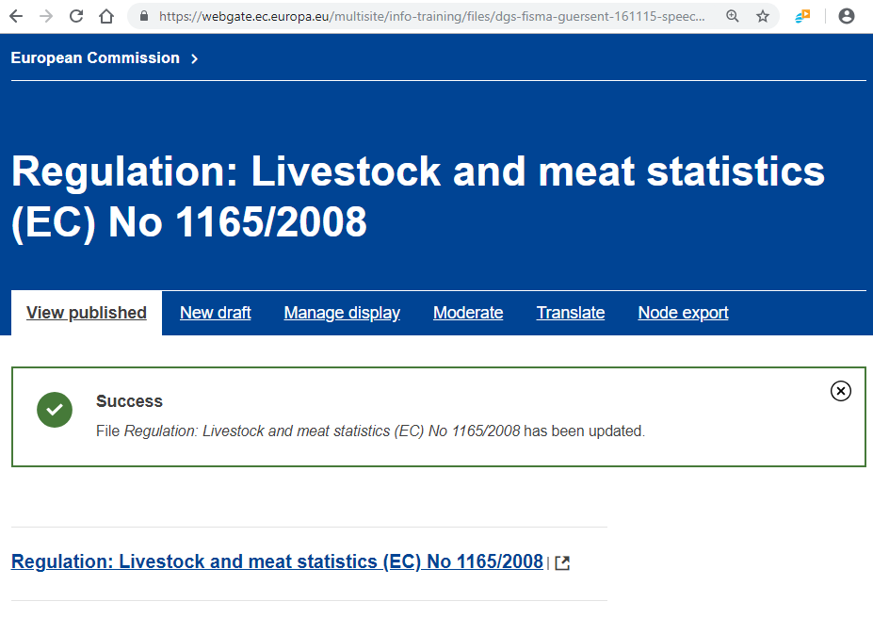
Save as published: 2nd possiblity
If you picked a EUR-Lex document that has not yet had a file node created for it, you will see a screen similar when you uploaded a file.
In this case, keep a note of the URL of your new file node,
and join it to your request for access to the /info site CMS

Slide 20
Replace an existing file with a new version

Slide 21
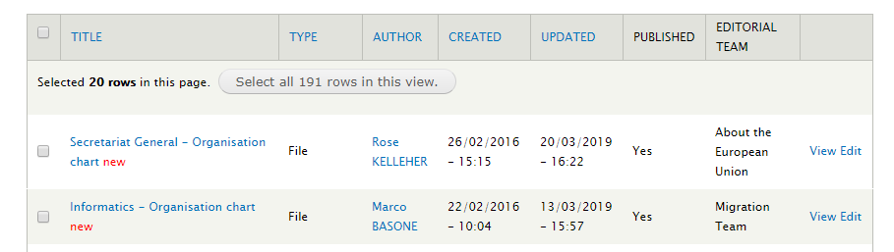
Find the file you want to update
In this exercise, we’ll simulate replacing a department’s organisation chart with an updated version.
In the training environment:
On the black tool bar at the top of the page, click Content
In the Title contains field, enter the word ‘organisation’ and click Search
The seach results will mostly be org charts of different commission departments
Pick one org chart, and click the edit link on the far right of the row

Slide 22
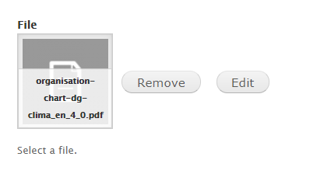
Edit (don’t remove)
Scroll down to the File field where you see a thumbnail of the file, next to a Remove and an Edit button.
Click the edit button. This will open the Edit document dialogue box.
Do not use the Remove button when updating a file, as this operation will generate a new url to download the file.
Since site users frequently bookmark links to documents they need to refer back to often, it’s important that these URLs are stable.
Using the Edit button allows us to do that.

Slide 23
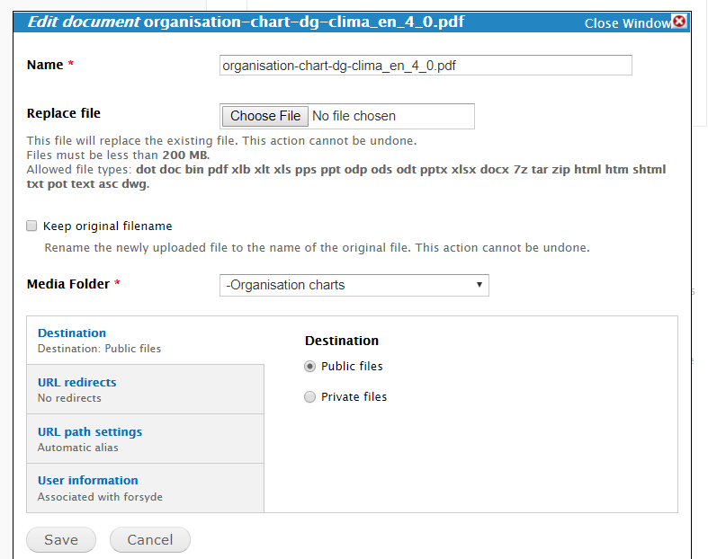
Upload the new version
Once the Edit document window loads
use the Replace file field to upload the file from your pc
use the same test file you uploaded before
at the bottom left of the window, click save
scroll down, select the Publishing options tab and save as Needs review, as before.
Keep a note of the url of the file node that you have updated to join to your request for access to the /info site CMS.

Slide 24
Add another language version of a file

Slide 25
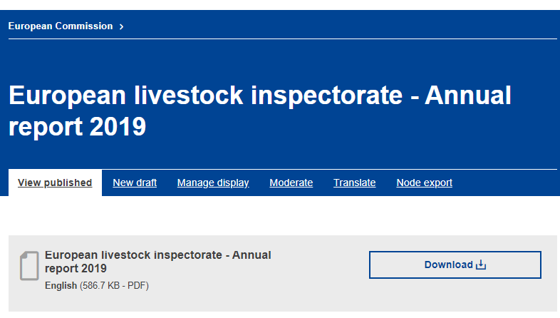
Translate tab
In this exercise, we will simulate adding a new language version of the first file you added
Go to the front end of the file you uploaded in the first exercise
Hint: paste the URL you saved into your browser bar
Click the translate tab

Slide 26
Partially translated interface of the CMS
Find the language you want to add in the list.
Click Add on the right hand side for your chosen language
Choose a language that you are familiar with.
This is because parts of the CMS back end are translated, and will display in the target language while you are working on translations.
If you choose a language you don’t speak, you may get lost.

Slide 27
Upload the new language version
Enter the title of the file in the target language
Hint: you can copy-paste the title in the target language from the document itself
If you don’t enter the translated title, the English title will be shown to site users, which negatively impacts user experence
Scroll down to the File field where you see an thumbnail image of the existing file
Click Remove. Wait for the field to refresh, then click Browse
Select the file you want to upload from your computer
Hint: use the 2nd test file you downloaded on slide 5
Remember to follow the naming convention. The new file name should be the same as the source language file name, with the relevant language suffix)
Upload and save
Do not use the Edit button when updating a file, as this operation will replace the source language file.

Slide 28
Available languages are displayed
On the Publishing options tab at the bottom left, select Moderation state: Needs review
Click Save
On the front end, you now have an expandable link to the available languages for that file

Slide 29
That’s it!
You are now a proficient user of the file content type.
Be sure to keep the 3 urls you worked on, to join to your CMS access request:
1. a file you uploaded, which has 2 language versions
2. a file node that links to EUR-Lex, that you either created or that already existed
3. an organisation chart that you updated with a new version
Next, go back to the wiki space where you downloaded this presentation (link below) and complete the exercises.
https://webgate.ec.europa.eu/fpfis/wikis/pages/viewpage.action?pageId=328965826

Slide 30
file content type
For any questions or feedback about this presentation, please email
europamanagement@ec.europa.eu

